Slide 1



Sales Analysis of E-commerce Website
View in Power BI
Last data refresh:
2/21/2025 8:23:27 PM UTC
Downloaded at:
2/21/2025 8:27:58 PM UTC

Slide 2
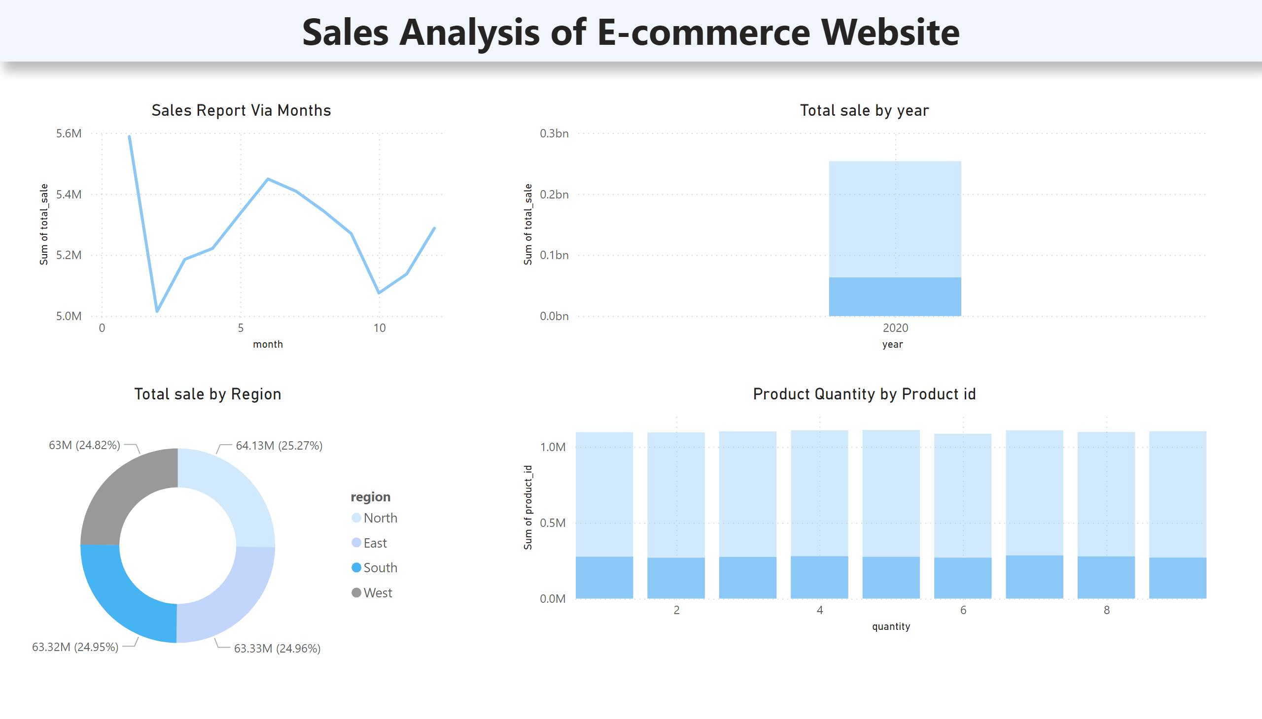
Page 1
Notes:
Sales Report Via Months
No alt text provided
Total sale by Region
No alt text provided
Product Quantity by Product id
No alt text provided
Total sale by year
No alt text provided
textbox
No alt text provided

